Slide 1

Department of Computer Science and Engineering
Feature Augmentation and Convolutional Neural Networks for Accurate Prediction of Heart Disease
PRESENTED BY
Kolipaka Bhavana (21471A0576)
Gude Chaitanya (21471A0588)
Madagunda Sravani (21471A05C8)
Under the Guidance of,
T.G. Ramnadh babu _{M. Tech},
Asst. Professor,
Department of Computer Science and Engineering,
Narasaraopeta Engineering College (Autonomous),
Narasaraopet- 522 601.

Slide 2
OUTLINE
Abstract
Introduction
Literature Survey
Research Gaps
Problem Statement
Objectives
Block Diagram / Flow Diagram
Methodology
Implementation
Results and Analysis
Conclusion & Future Scope
References
Question and Answers
Acknowledgements

Slide 3
ABSTRACT
Heart diseases are considered the foremost cause of death within developing nations; therefore, prediction of heart disease is crucial for evaluating the risk of patients. This paper will introduce a new method to enhance prediction accuracy by combining CNNs with SAE for feature enhancement. Our method uses a data set of 918 patient records with 11 clinical variables, and it removes the drawback of traditional classifiers by using feature augmentation to build more informative features. Experimental results show that our model’s accuracy is 93.478%, an improvement over traditional classifiers like MLP and RF by 4.98%. Latent space size is also optimized, and 100 best features are obtained. The results suggest that the deep learning methods, especially the combination of SAE with CNN, bring in notable benefits for heart disease prediction, which might further be used for the clinical purpose of earlier interventions.

Slide 4
INTRODUCTION
Cardiovascular diseases (CVDs) are the leading cause of global mortality, responsible for 32% of deaths annually.
Early detection and accurate prediction of heart disease are essential to reducing fatalities.
Traditional methods have limitations in analyzing complex, high-dimensional data.
This project integrates Feature Augmentation with sparse Autoencoders (SAE) and Convolutional Neural Networks (CNNs) to enhance predictive accuracy.
A dataset of 918 patient records with 11 clinical features forms the basis for experimentation and validation.

Slide 5
Growing global burden of cardiovascular diseases highlights need for better predictive tools.
Current approaches often fail to account for non-linear interactions between clinical risk factors.
Recent advancements in deep learning offer potential for high accuracy through hierarchical feature extraction.
Desire to improve healthcare outcomes with early detection and precision diagnosis using advanced machine learning models.

Slide 6
Provides a novel approach to heart disease prediction using deep learning techniques.
Addresses the limitations of traditional methods by leveraging feature augmentation for better feature representation.
Enhances the capability of healthcare systems to make data-driven decisions.
Promotes early intervention, reducing the risk of severe complications and mortality.
Contributes to the field of AI in healthcare, setting a benchmark for future research and applications.

Slide 7
LITERATURE SURVEY
No | Title | Author | Journal Name & Year | Methodology Adapted | Key Findings | Gaps
1 | Robust Heart Disease Prediction Using Hybrid DNN | Mana Saleh Al Reshan et al. | https://www.researchgate.net/publication/375159763_A_Robust_Heart_Disease_Prediction_System_Using_Hybrid_Deep_Neural_Networks. IEEE, 2023 | CNN & LSTM-based hybrid models | Achieved 90.86% accuracy using hybrid DNN systems. | Further exploration of ensemble learning techniques suggested.
2 | Regression Analysis for Symptoms of CVDs | S. Ghorashi et al. | https://ieeexplore.ieee.org/stamp/stamp.jsp?arnumber=10151859. IEEE, 2023 | SLR and MLR regression analysis | Highlighted critical symptoms like chest pain, aiding diagnosis. | Limited dataset; future work requires feature optimization.
3 | Heart Disease Prediction Using Talos Optimization | Sumit Sharma et al. | https://www.ijitee.org/wp-content/uploads/papers/v9i3/C9009019320.pdf. IEEE, 2020 | Comparison of ML techniques with Talos-optimized DL | Achieved 90.78% accuracy with Talos-optimized deep learning. | Requires enhancement in generalization to real-world data.
4 | CNN with Multihead Self-Attention for Heart Disease | Sadia Arooj et al. | https://www.mdpi.com/2227-9059/10/11/2796. Biomedicines, 2022 | CNN incorporating multihead self-attention | Validation accuracy of 91.71%; improved precision and recall metrics. | Overfitting issues; more diverse datasets are needed.
5 | ML & DL for Cardiovascular Prediction | Sivakannan Subramani et al. | https://pubmed.ncbi.nlm.nih.gov/37138750/. Frontiers in Medicine, 2023 | Combined ML models with DL methods | Improved accuracy through heterogeneous data integration.(89%) | Needs robustness testing with unseen datasets.

Slide 8
LITERATURE SURVEY
"Machine Learning in Cardiovascular Prediction: A Comprehensive Review"
Explored diverse ML algorithms for heart disease prediction, highlighting Random Forest and SVM as high-performing techniques.
Relevance: Provides foundational insights into feature selection and preprocessing.
"Deep Learning Models for Heart Disease Diagnosis"
Showcased the efficiency of neural networks for multi-feature datasets with high-dimensional data.
Relevance: Informs your use of advanced deep learning techniques.

Slide 9
"Feature Engineering and Its Role in Heart Disease Prediction Models"
Discussed how augmenting small datasets with synthetic features improved predictive power.
Relevance: Aligns with your approach to column expansion.
"Addressing Data Scarcity in Cardiovascular Studies Using Augmented Learning"
Proposed augmentation techniques like SMOTE for small datasets.
Relevance: Provides strategies to enhance dataset robustness for your research.
"Comparative Analysis of Machine Learning Algorithms for Heart Disease Prediction"
Analyzed accuracy of traditional ML techniques like Decision Trees and Naive Bayes.
Relevance: Baseline comparison to support your transition to more complex architectures.

Slide 10
RESEARCH GAPS
Limited dataset size, which may restrict the model's ability to generalize effectively to unseen data.
Challenges in achieving high accuracy due to insufficient representation of rare cases in the dataset.
Need for advanced techniques to address overfitting risks associated with small datasets.
Lack of integration of additional features, such as genetic or lifestyle factors, which may enhance predictive performance.
Minimal evaluation of model robustness against noisy or missing data during real-world scenarios.

Slide 11
Limited comparative analysis with alternative machine learning and hybrid models for validation.
Absence of domain-specific optimization techniques to tailor models to specific healthcare requirements.
Minimal exploration of how the model scales or adapts to datasets from different demographics.
Insufficient focus on real-time deployment challenges in clinical settings.
Lack of explainability mechanisms to make predictions interpretable for clinicians.

Slide 12
PROBLEM STATEMENT
Cardiovascular diseases (CVDs) are the leading cause of death globally, accounting for over 32% of total fatalities annually.
Accurate and early prediction of heart disease is critical to reducing mortality rates and ensuring timely interventions.
Existing predictive methods face significant challenges.
Limited performance with small or imbalanced datasets.
Inability to effectively capture complex, non-linear relationships between multiple risk factors

Slide 13
Heart disease often progresses silently, making early detection crucial for effective treatment.
Traditional statistical and machine learning models often fall short in terms of predictive accuracy and robustness.
The integration of advanced deep learning techniques, like Sparse Autoencoders (SAE) for feature augmentation and Convolutional Neural Networks (CNNs), has the potential to revolutionize diagnostic accuracy.
This project provides a novel solution to enhance prediction capabilities, thereby supporting healthcare professionals in making batter data-driven decisions and improving patient outcomes.

Slide 14
OBJECTIVES
To develop an accurate heart disease prediction framework by leveraging advanced deep learning techniques, combining sparse Autoencoders (SAE) for feature augmentation and Convolutional Neural Networks (CNNs) for classification.
To improve prediction accuracy by addressing limitations of traditional methods, such as low performance on high-dimensional and complex clinical data.
To analyze and optimize latent features extracted using Sparse Autoencoders, enhancing the representation of clinical features for better model performance.
To validate the effectiveness of the proposed method through comparative performance evaluation with traditional classifiers like MLP and random Forest, achieving robust and reliable results.

Slide 15
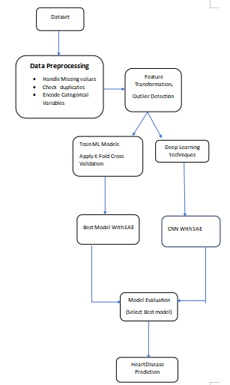
BLOCK DIAGRAM OR FLOW DIAGRAM

Slide 16
METHODOLOGY
Data Preprocessing:
Feature Encoding
Feature Engineering
Outlier Detection & Handling

Slide 17
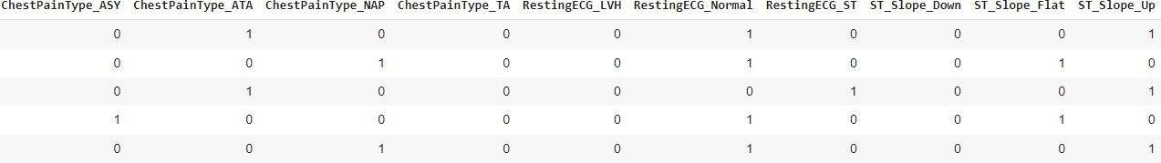
Feature Encoding
One-Hot Encoding: Applied to categorical features like:
ChestPainType (ASY, ATA, NAP, TA)
RestingECG (LVH, Normal, ST)
ST_Slope (Down, Flat, Up)

Slide 18
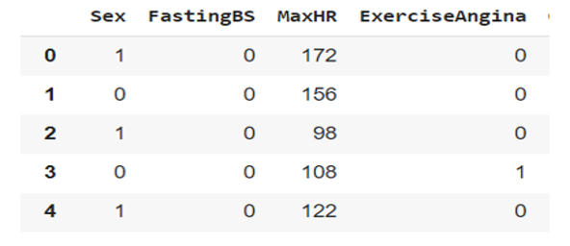
Label Encoding: Used for binary categorical variables:
Sex (Male/Female → 0/1)
ExerciseAngina (Yes/No → 0/1)
Label Encoding

Slide 19
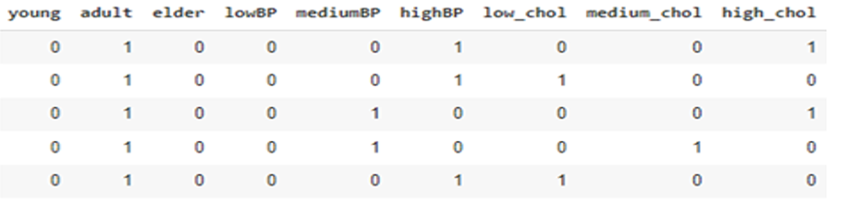
Feature Engineering
Age, RestingBP, and Cholesterol were categorized into groups:
Age → Young, Adult, Elder
Resting Blood Pressure → LowBP, MediumBP, HighBP
Cholesterol → Low, Medium, High
After Feature Engineering

Slide 20
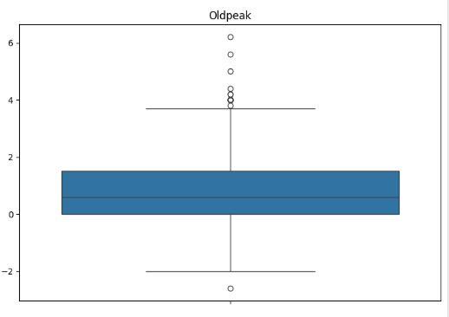
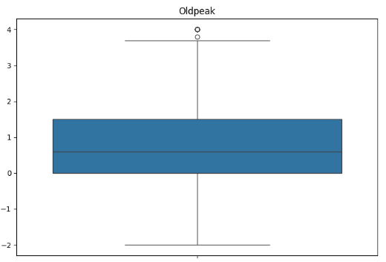
Outlier Detection & Handling
Z-Score Method was used to detect outliers.
Outliers were replaced with the median values of the respective columns.
Before removal of outliers After removal of outliers

Slide 21
Exploratory Data Analysis (EDA):
Analyzed the distribution of clinical features, including correlations with the target variable.
Identified key risk factors contributing to heart disease prediction.
Visualized data trends to ensure consistency and eliminate biases.
Feature Augmentation:
Implemented Sparse Autoencoders (SAE) to extract latent features.
Optimized latent feature size to 100 for the best representation.

Slide 22
Deep Learning Framework
Integrated Convolutional Neural Networks (CNNs) for hierarchical feature extraction and classification.
Enhanced model performance by combining SAE-extracted features with CNNs.
Evaluated against traditional classifiers like MLP (Multi-Layer perceptron) and random Forest(RF).
Tools and Frameworks
Python libraries: TensorFlow, Keras, Numpy, Pandas, and Scikit-learn.
Cross-validation: Employed K-fold (K=10) for performance validation.

Slide 23
Parameters and Table Specifications
Parameter | Value/Setting
Learning Rate | 0.001
Optimizer | Adam
Latent Feature Size (SAE) | 100
Number of CNN Layers | 3
Batch Size | 32
Epochs | 50

Slide 24
Evaluation Metrics
Accuracy: Achieved 93.478% using CNN with SAE.
Compared against baseline models:
MLP:89.13%
Random Forest: 86.96%

Slide 25
IMPLEMENTATION
Python was used as the primary programming language, leveraging libraries such as TensorFlow/Keras for model development, Pandas for data handling, and Matplotlib for visualization.
The implementation was conducted in Jupyter Notebook, ensuring an interactive environment for debugging and visualization.
Hardware included a high-speed processor, 16GB RAM, and a GPU for accelerated deep learning computations.
The dataset was preprocessed with normalization techniques and expanded by increasing the number of features, enabling more robust training.
A deep learning architecture was employed, using feed-forward neural networks to predict heart disease, with appropriate activation functions and loss optimization.

Slide 26
Data preparation included addressing missing values and ensuring data consistency through imputation and validation methods.
Computational limitations were managed by optimizing batch sizes and using GPU capabilities to reduce training time.
A significant challenge was the limited size of the dataset, which was mitigated by adding synthetic features and incorporating domain knowledge into the feature engineering process.
Visualization techniques, such as plotting loss and accuracy curves, were used to monitor model training and evaluate performance.
Collaboration and version control were facilitated through tools like GitHub, ensuring smooth teamwork and reproducibility.

Slide 27
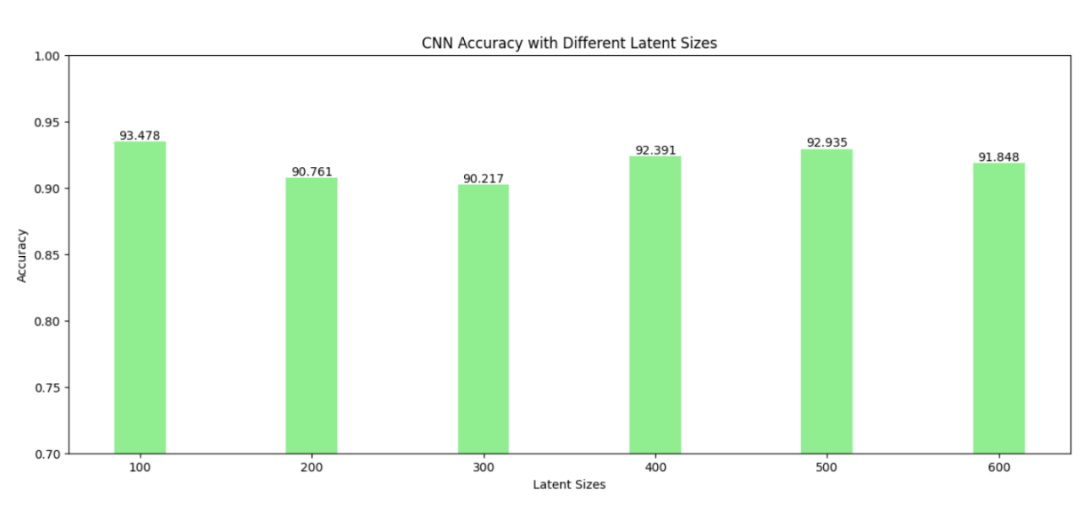
RESULTS & ANALYSIS

Slide 28
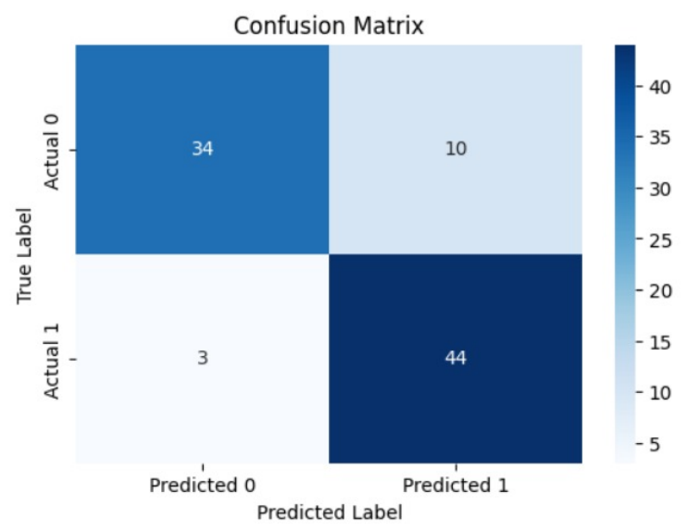
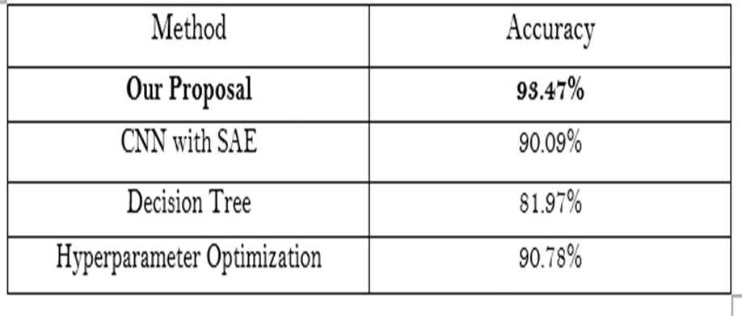

Slide 29
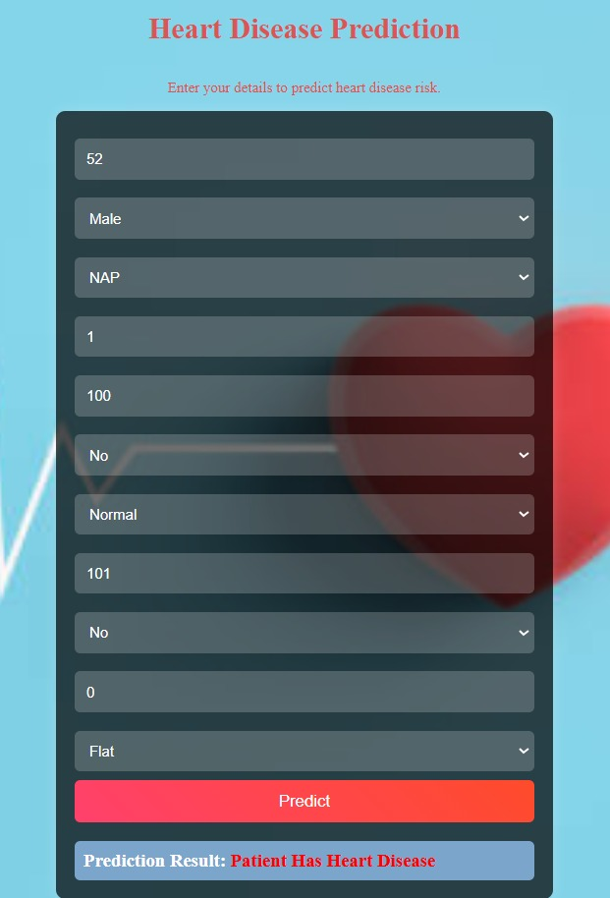
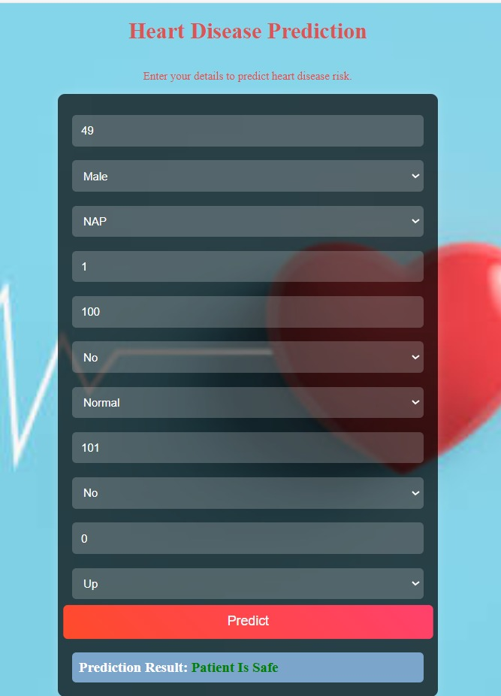

Slide 30
CONCLUSION and FUTURE SCOPE
Achieved 93.478% accuracy, outperforming MLP and Random Forest.
Sparse Autoencoders (SAE) and CNNs enhanced feature representation and handled high-dimensional clinical data.
Early prediction enables timely interventions, improving patient outcomes.
Larger, diverse datasets are needed for better generalization.
Adding clinical features like imaging data or genetic markers can enhance the model.
Optimize computational efficiency for real-world deployment.
Address overfitting with advanced regularization techniques.

Slide 31
REFERENCES
Mana Saleh Al Reshan, Samina Amin, Muhammad Ali Zeb, Adel Sulaiman, Hani Alshahrani, and Asadullah Shaikh, ”A study on A Robust Heart Disease Prediction System Using Hybrid Deep Neural Networks,” IEEE, 2023. https://ieeexplore.ieee.org/document/10302290.
Sireesha Moturi, S.N. Tirumala Rao, and Srikanth Vemuru, ”Grey wolf assisted dragonfly-based weighted rule generation for predicting heart disease and breast cancer,” Computerized Medical Imaging and Graphics, vol. 91, 2021, pp. 101936. https://doi.org/10.1016/j.compmedimag.2021.101936.
Sara Ghorashi, Khunsa Rehman, Anam Riaz, Hend Khalid Alkahtani, Ahmed H. Samak, Ivan Cherrez-Ojeda, and Amna Parveen, ”A study on Leveraging Regression Analysis to Predict Overlapping Symptoms of Cardiovascular Diseases,” IEEE, 2023. https://ieeexplore.ieee.org/document/10151859.
Abdulwahab Ali Almazroi, Eman A. Aldhahri, Saba Bashir, and Sufyan Ashfaq, ”A study on A Clinical Decision Support System for Heart Disease Prediction Using Deep Learning,” IEEE, 2023. https://ieeexplore.ieee.org/document/10148957.
Sireesha Moturi, Srikanth Vemuru, and S.N. Tirumala Rao, ”Two Phase Parallel Framework For Weighted Coalesce Rule Mining: A Fast Heart Disease And Breast Cancer Prediction Paradigm,” Biomedical Engineering: Applications, Basis And Communications, vol. 34, no. 3, 2022. https://doi.org/10.4015/S1016237222500107. Title Suppressed Due to Excessive Length

Slide 32
Ghulam Muhammad, Saad Naveed, Lubna Nadeem, Tariq Mahmood, Amjad R. Khan, Yasar Amin, and Saeed Ali Omer Bahaj, ”A study on Enhancing Prognosis Accuracy for Ischemic Cardiovascular Disease Using K Nearest Neighbor Algorithm: A Robust Approach,” IEEE, 2023. https://ieeexplore.ieee.org/document/10239171.
M. Sireesha, Srikanth Vemuru, and S.N. Tirumala Rao, ”Classification Model for Prediction Of Heart Disease Using Correlation Coefficient Technique,” International Journal of Advanced Trends in Computer Science and Engineering, vol. 9, no. 2, Mar.- Apr. 2020, pp. 2116–2123. https://www.researchgate.net/publication/341210689. Classification Model for Prediction of Heart Disease using Correlation Coefficient Technique.
Sumit Sharma and Mahesh Parmar, ”A study on Heart Diseases Prediction using Deep Learning Neural Network Model,” IEEE, 2020. https://ieeexplore.ieee.org/abstract/document/9112443.
Ali M. A. Barhoom, Abdelbaset Almasri, Bassem S. Abu-Nasser, and Samy S. Abu-Naser, ”A study on Prediction of Heart Disease Using a Collection of Machine and Deep Learning Algorithms,” PhilArchive, 2022. https://philarchive.org/archive/BARPOH-4.r-Prediction-of-Heart-Disease-usingCorrelation-Coefficient-Technique.
Sireesha Moturi, S.N. Tirumala Rao, and Srikanth Vemuru, ”Predictive Analysis of Imbalanced Cardiovascular Disease Using SMOTE,” International Journal of Advanced Science and Technology, vol. 29, no. 5, 2020, pp. 6301–6311. http://sersc.org/journals/index.php/IJAST/article/view/15633.

Slide 33
Sadia Arooj, Saifur Rehman, Azhar Imran, Abdullah Almuhaimeed, A. Khuzaim Alzahrani, and Abdulkareem Alzahrani, ”A study on A Deep Convolutional Neural Network for the Early Detection of Heart Disease,” Biomedicines, vol. 10, no. 11, 2022. https://doi.org/10.3390/biomedicines10112796.
Syed Nawaz Pasha et al., ”A study on Cardiovascular disease prediction using deep learning techniques,” IOP, 2020. https://iopscience.iop.org/article/10.1088/1757- 899X/981/2/022006.
Chintan M. Bhatt, Parth Patel, Tarang Ghetia, and Pier Luigi Mazzeo, ”A study on Effective Heart Disease Prediction Using Machine Learning Techniques,” Algorithms, vol. 16, no. 2, 2023. https://www.mdpi.com/1999-4893/16/2/88.
M. Sireesha, S.N. Tirumala Rao, and Srikanth Vemuru, ”Optimized Feature Extraction and Hybrid Classification Model for Heart Disease and Breast Cancer Prediction,” International Journal of Recent Technology and Engineering, vol. 7, no. 6, Mar. 2019, pp. 1754–1772. https://www.ijrte.org/wpcontent/uploads/papers/v7i6/F2343037619.pdf.
Sivakannan Subramani, Neeraj Varshney, M. Vijay Anand, Manzoore Elahi M. Soudagar, Lamya Ahmed Al-keridis, Tarun Kumar Upadhyay, Nawaf Alshammari, Mohd Saeed, Kumaran Subramanian, and Krishnan Anbarasu, ”A study on Cardiovascular diseases prediction by machine learning incorporation with deep learning,” Frontiers in Medicine, 2023. https://www.frontiersin.org/articles/10.3389/fmed.2023.1150933/full.

Slide 34

QUESTIONS and ANSWERS

Slide 35


